Slide 1
ASTU
Computer Science & Engineering (CSE)

Slide 2

ICPC
Presented by: Mukerem Ali
Slides by: Yohannes Fikru

Slide 3
OUTLINE
#1
What is CSEC?
#2
What is ICPC?
#3
WHY ICPC?
#4
#4
THE CONTEST
THE CONTEST
#5
2019 World Finals

Slide 4
#1. What is CSEC?
CSEC stands for Computer Science and Engineering Club
CSEC has 3 Divisions namely: Competitive Programming(ICPC), Development and Capacity Building.
CSEC
Competitive Programming
Development
Capacity Building

Slide 5
CSEC CPD
CSEC CPD is the division that conducts Competitive programming and aims to prepare students for the International Collegiate Programming Contest (ICPC)

Slide 6
#2. what is ICPC?
I
C
P
C
INTERNATIONAL
COLLEGIATE
PROGRAMMING
CONTEST
Multi-tiered
University/college students
Problem Solving
Computation

Slide 7
#3. Why ICPC?
01
Help students Interact with students from other universities.
03
A platform to encourage the next generation of computing professionals..
To sharpen and demonstrate students problem solving skill.
02

Slide 8

ICPC TIERS
1
2
3
NATIONAL
REGIONAL
WORLD

Slide 9
ACM ICPC REGIONALS
EUROPE
ASIA
NORTH AMERICA
SOUTH PACIFIC
LATIN AMERICA
AFRICA/MIDDLE EAST

Slide 10
ICPC History
ACM hosted the first World Finals
Michigan State University won
1970
1989
1977
Local Contest held at Texas A&M
UPE Computer Honor Society
Contest headquarters have been located at Baylor University.

Slide 11
WORLD FINALS Hosts
Marrakech, Morocco
South Dakota, USA
Porto, Portugal
2014
2016
2018
2015
2017
2019
Yekaterinbug, Russia
Phuket, Thailand
Beijing, China

Slide 12



ICPC History
CONTESTANTS
52,709
2018
UNIVERSITIES
3,233
COUNTRIES
110

Slide 13
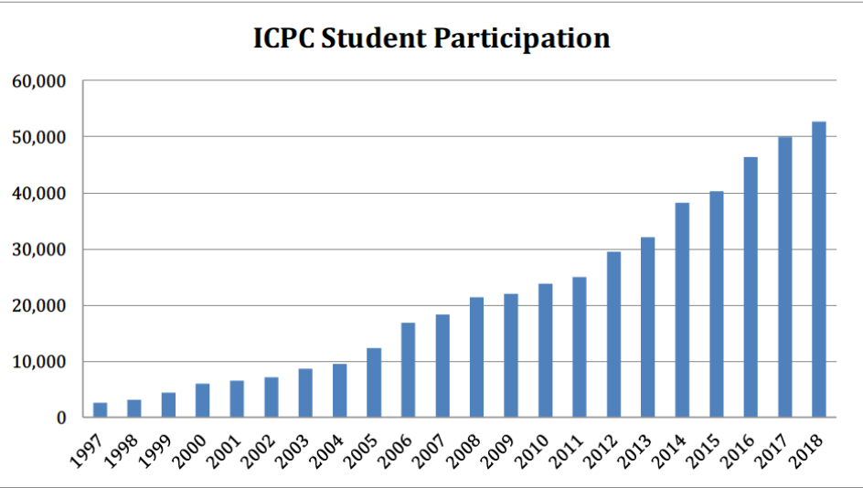
ICPC History
SUPERLINER GROWTH

Slide 14





WHY ICPC?
To Host World Final
Cities invest Millions of Dollars
ICPC
Extremely prestigious
Winners get cash prize
Russian Universities
Champions get $15,000
Gold medalists - $7,500
Broadcasted Live
Silver - $6,000
World Finals On Television
Bronze - $3,000

Slide 15
WHY ICPC?
An outlet for top students
1
4
Learn to code and work in team
Easier to find a job!
2
5
Regional winners invited to week-long world finals
Learn Many useful algorithms,
mathematical insights
3
6
It is also fun

Slide 16
Contest Organization
LOCAL
REGIONAL
WORLD
University Competitions
Typically 50-100 Teams
Up to 100 teams invited
Run by Regional contest staff
IBM Sponsorship started in 1997
Run by Local Staffs
Regional Winners get to go to World Finals
Held in different country each year

Slide 17
#4. The Contest

Slide 18


Contestant Eligibility
A STUDENT
Enrolled in a degree program at the team’s institution
May compute for only one institution during a contest year
Who has computed in two world finals is NOT eligible to compete
Who has computed in five Regional Contests is NOT eligible to compete

Slide 19
Contestant Eligibility
All team members must attend all contest activities as it result in automatic disqualification
The coach and all team members must be fully registered at the ICPC Registration System BEFORE computing in a regional event.

Slide 20





THE CONTEST
TIME
4-5 Hours
TEAM
BALLOON
3 STUDENTS
Each problem is associated with a color
COMPUTER
One Computer per team
PROBLEMS
8 - 13

Slide 21
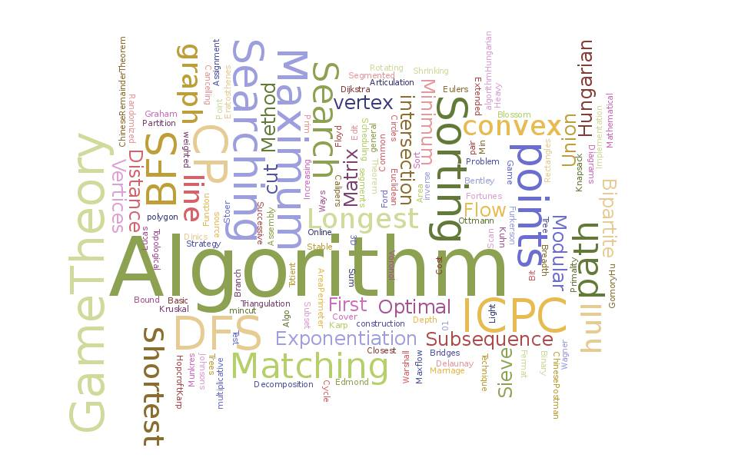
THE CONTEST
while ( ! isTimeout() ) {
read();
think();
program();
//debug();
submit();
}

Slide 22
CONTEST RULES
01
No other electronic devices or internet allowed
02
Not allowed to converse with anyone except team members
03
Judge by some test cases
Pass all test cases = solve the question
If fail, can resubmit
04
Can submit a clarification request to a judge
05
Winner is the team that solves the most problems in the least time!

Slide 23


Slide 24

ONLINE JUDGE
AC
PE
WA
CE
Accepted
Presentation Error
Wrong Answer
Compiler Error

Slide 25
ONLINE JUDGE
RE
TL
ML
Run Time Error
Time Limit Exceeded
Memory Limit Exceeded

Slide 26
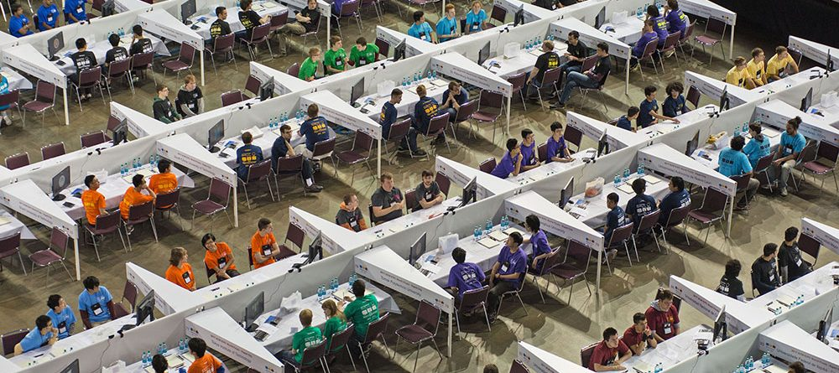
#5. 2019 WORLD FINALS

Slide 27
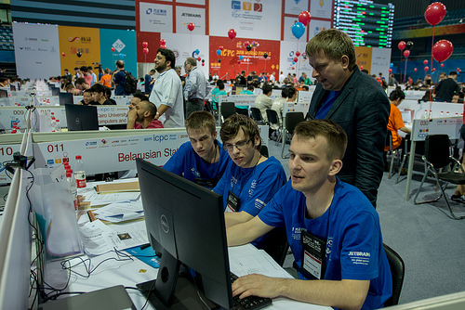

Slide 28
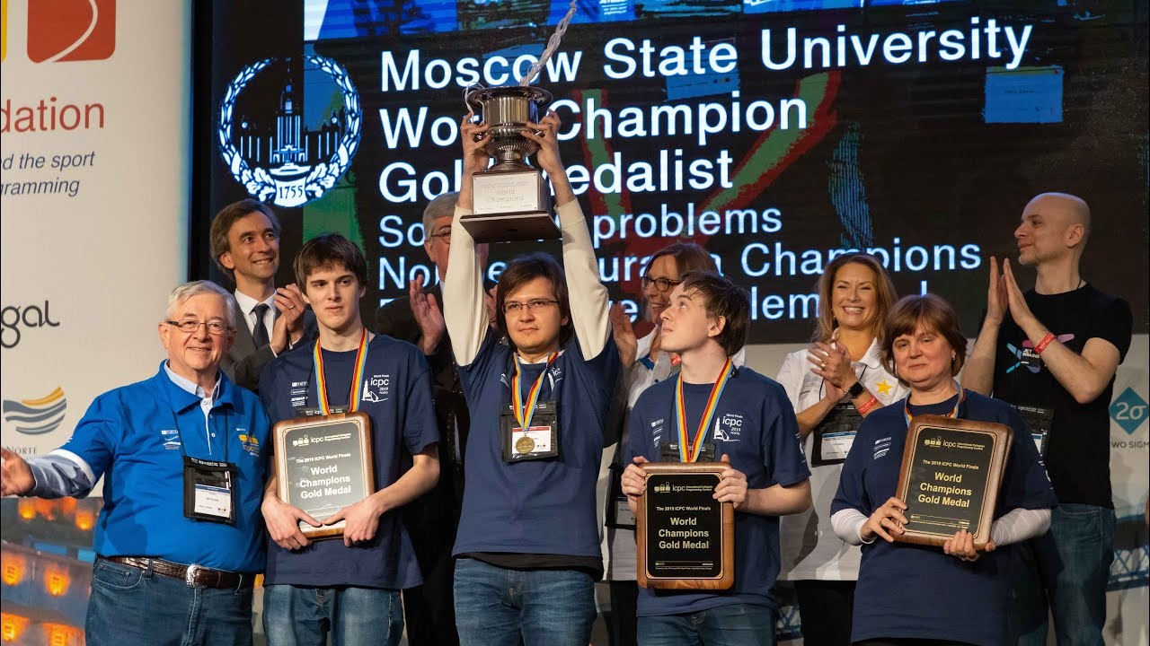
MOSCOW STATE UNIVERSITY - 2019 ICPC World Finals Champions

Slide 29
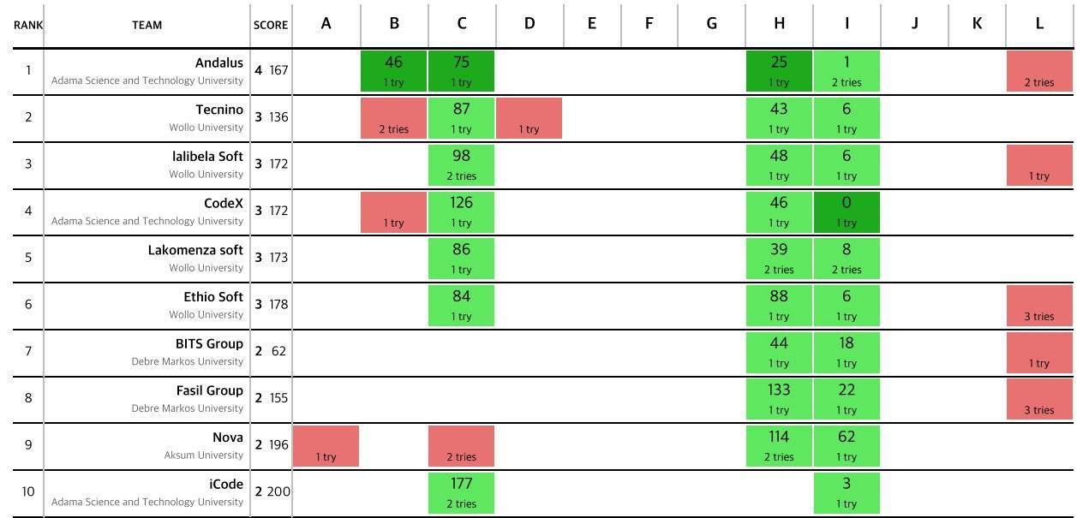
The scoreboard for the 4th Ethiopian Colligate Programming Contest

Slide 30
T H A N K YOU

